Slide 1
Introduction To Printed Circuit Boards
Dr. Steven Swanson
CSE176e/276e
swanson@cs.ucsd.edu

Slide 2
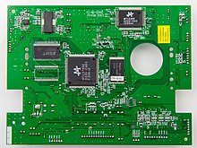
PCB Overview
PCBs provide electrical connectivity
Compact
Mass-manufacturable
Durable
Reliable
They comprise (usually) copper wires embedded in a composite matrix
Electrical components are soldered to one or both surfaces.
They are everywhere!
Many PCBs are easy to design and manufacture.
The board is ~$2 of that
The FCB cost $50 fully assembled in lots of 25
There’s no upper limit on cost or sophistication

Slide 3
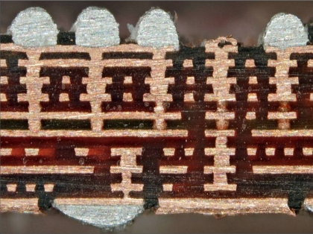
PCBs are Made of Layers
Silkscreen – documentation and labels
Metal – for making wires
Dielectric – insulation and mechanical structure
Solder mask – protective outer coating

Slide 4
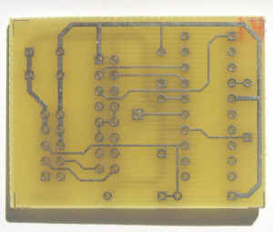
Metal Layers
The Metal layers
Conductive “traces” to connect components
Attaching components
More layers → more expensive
Top and bottom layers are for mounting components and routing traces
Internal layers can serve several purposes
Ground and power planes
Other signal planes
Internal routing layers

Slide 5
Metal Layers (cont.)
Thickness is measured in oz per square foot.
Standard copper is 1oz
About 0.034 mm

Slide 6
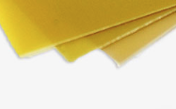
Dielectric
The dielectric is the insulator between metal layers
Most PCBs use FR4
“glass reinforced epoxy laminate”
i.e., fancy fiberglass
“FR” means “flame retardant”
Other specialized dielectrics are are available
To support high speed circuits
To manage thermal expansion
Bare FR4

Slide 7
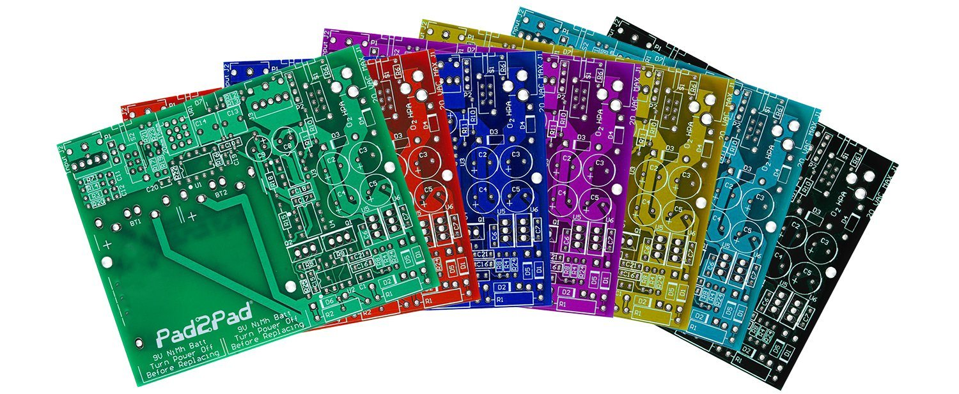
Solder Mask
Plastic coating on the top and bottom of the board
Protects the top and bottom metal from oxidation.
Helps prevent solder bridges
Gives the board color

Slide 8
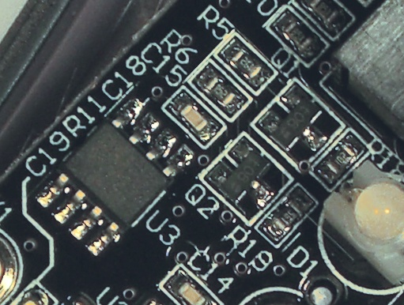
Silkscreen
It’s an opaque, (usually) white epoxy or polymer
It provides documentation and markings
References designators
Part outlines
Logos
Serial numbers etc.

Slide 9
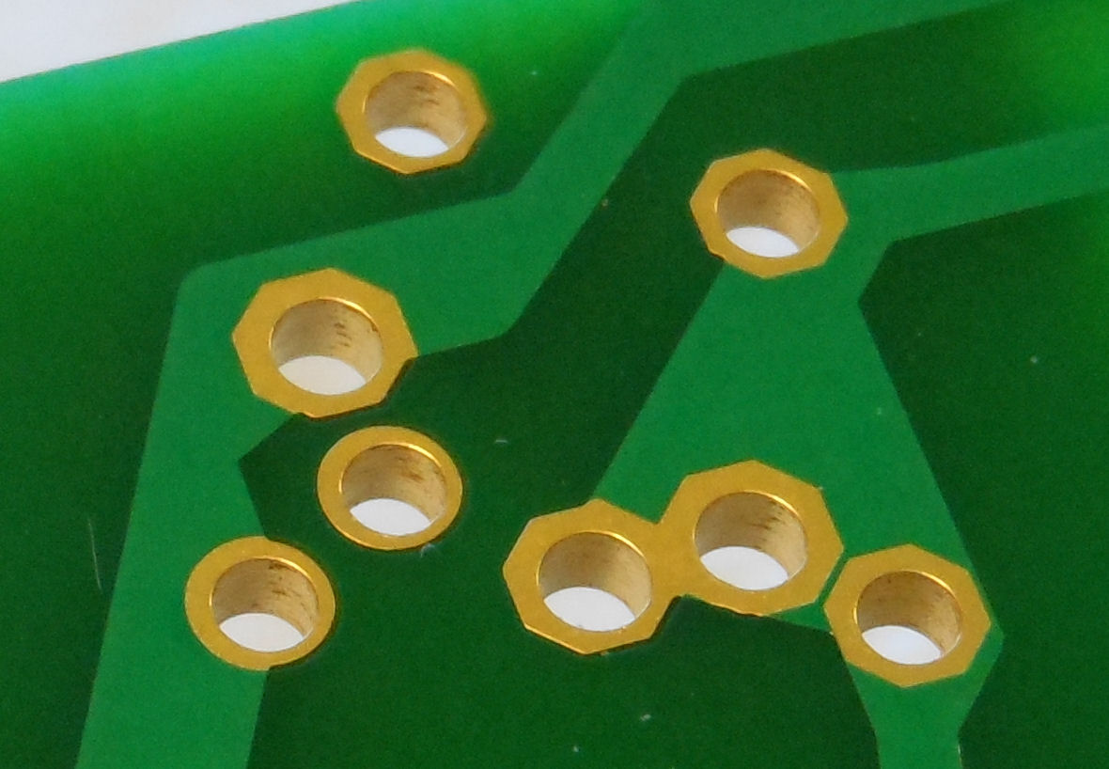
Making Connections Between Layers
Metal-plated holes connect metal layers.
Drill a hole
Electroplate it with copper
Cover it with a non-corroding metal.

Slide 10

Connecting Wires with “Vias”
Vias make electrical connections between layers
They are usually very small.
Often covered by solder mask
Typically, they pass through all layers

Slide 11
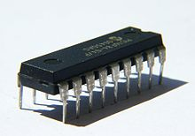
Mounting Components with Through-holes
Through-hole “pads”
Sized for the pin + solder
Significantly larger than vias
Draw backs
Takes up space in all layers (including back side of board)
Pin-to-pin spacing >= 1mm
Automated manufacturing is challenging

Slide 12
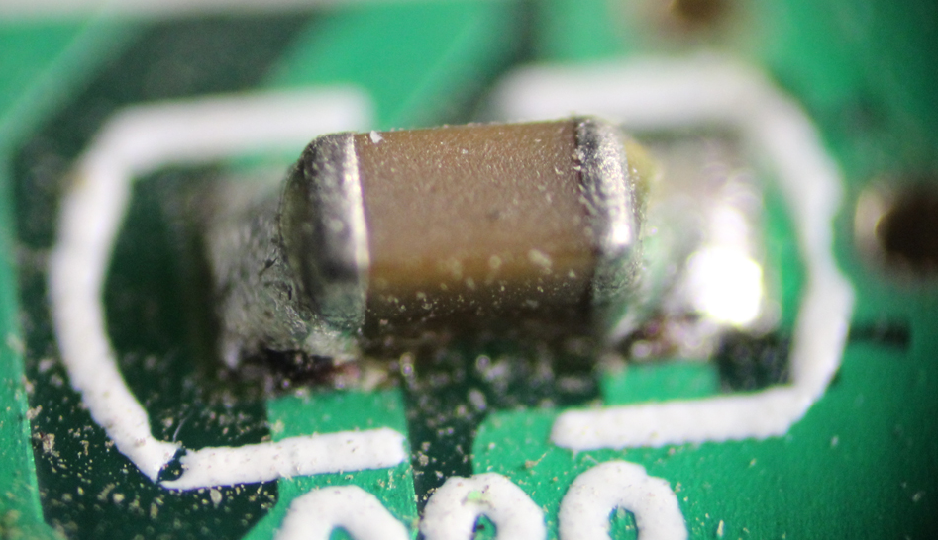
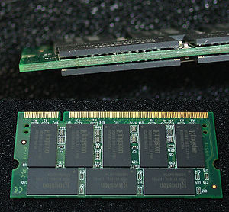
Surface Mount Devices (SMD)
No drill required
No pins
Smaller parts
Finer ‘pitch’ (pin-to-pin distance)
Parts on both sides
Easier automated placement
Pitch >= ~0.3 mm

Slide 14
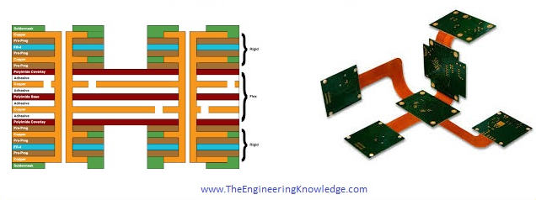
Lots of Choices, in Theory
There are many, many choices when designing a PCB
Mechanical – flexible, thick, thin
Layer count
Blind and buried vias
Electrical – copper thickness, dielectric characteristics
Thermal characteristics
We will get to make very few of them
Cheap, fast PCB manufacturers provide a standard setup. E.g.:
FR4
1oz copper
2, 4, or 6 layers
A few solder mask colors

Slide 15
Resources
Good PCB manufacturing videos
https://www.youtube.com/playlist?list=PL8zP8UuDk8a0ZNWiteC-7PHx1HCeBY0qB

Slide 17
Designing PCBs
Dr. Steven Swanson
CSE176e/276e

Slide 18
Steps for Designing PCBs
Create/acquire a library of components
Assemble your schematic
Lay out the board
Perform design checks
Generate CAM files
Check everything carefully
Submit for manufacturing

Slide 19
PCB Libraries
PCB Libraries tell the PCB design software about physical components
Engineering data
What kind of component is it?
What electrical connections does it have?
How will it connect to the PCB?
How should it appear on the PCB?
Manufacturing data
What is the part number?
Where can I purchase it?
…

Slide 20
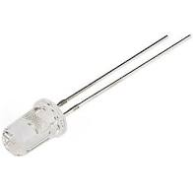
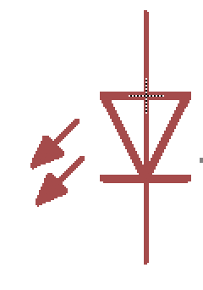
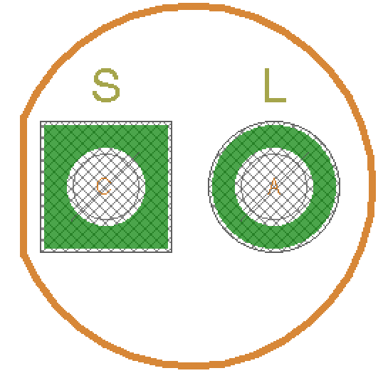
A Simple LED
The physical Part
Attribute | Value
Part Number | XAU252ae-22
Manufacture | LED Inc.
Schematic Symbol
PCB “Footprint”
A “Device”

Slide 21
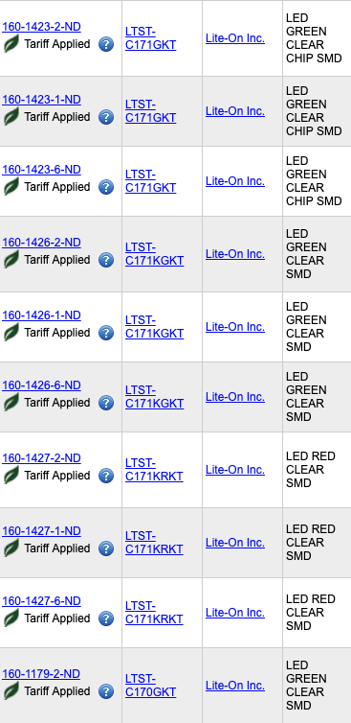
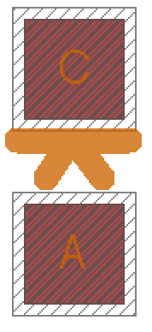
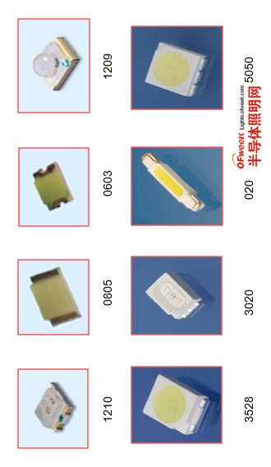
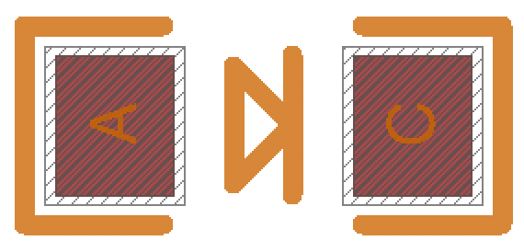
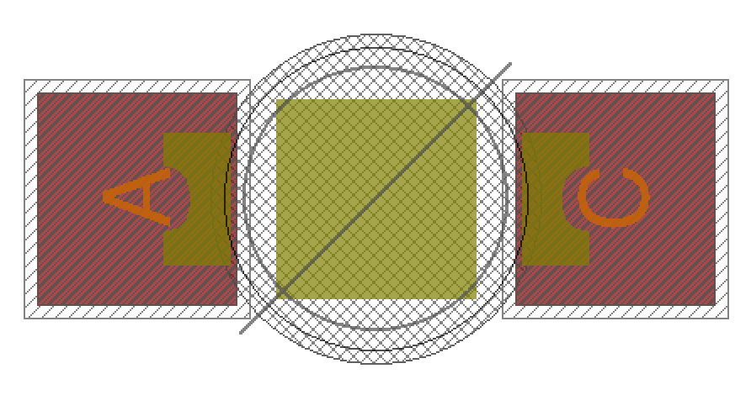
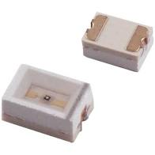
PCB Library
One Symbol
Many Packages
Many Parts

Slide 22
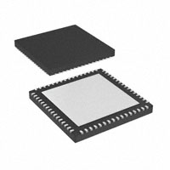
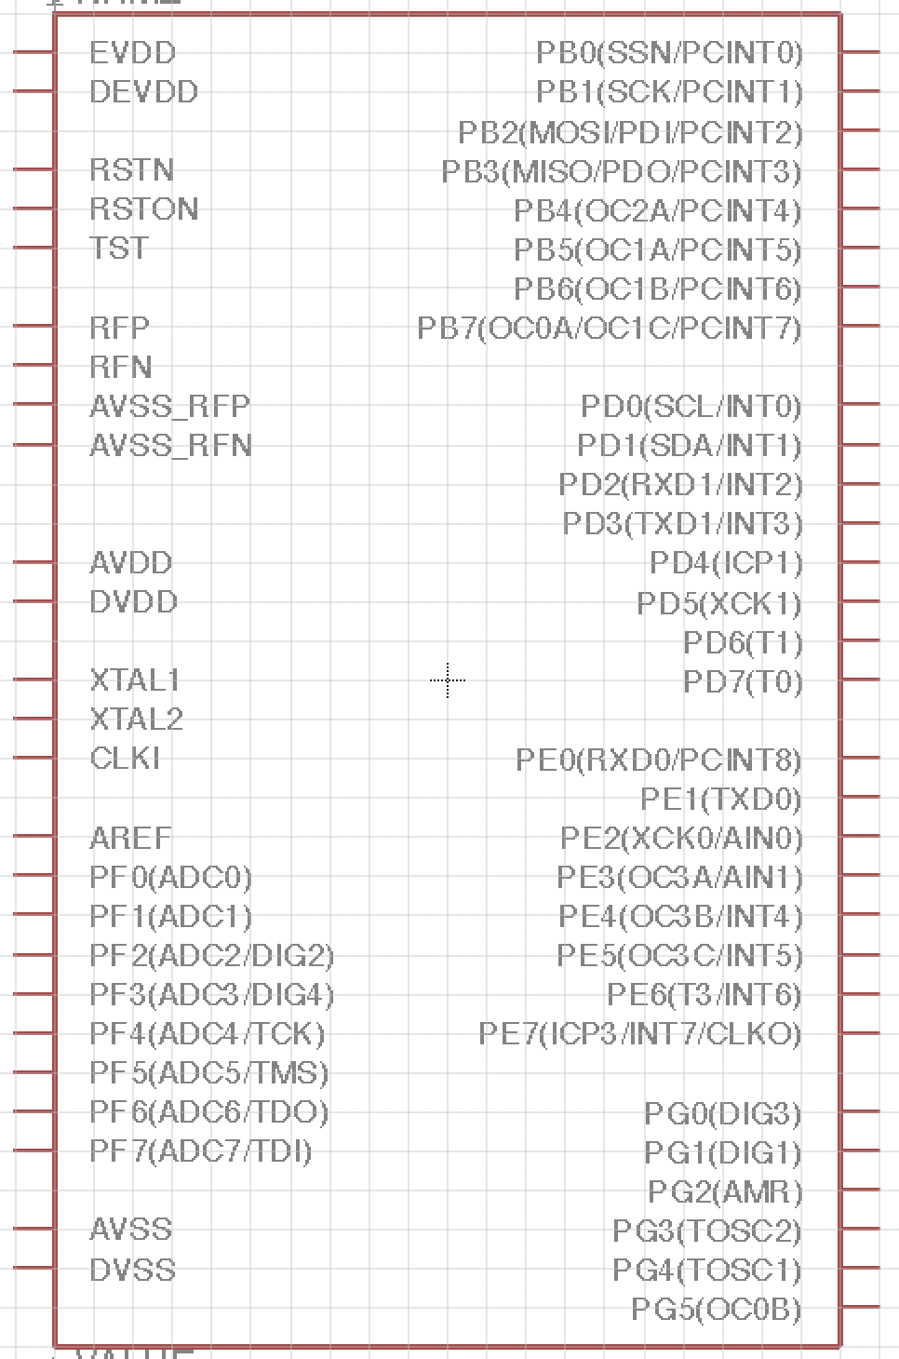
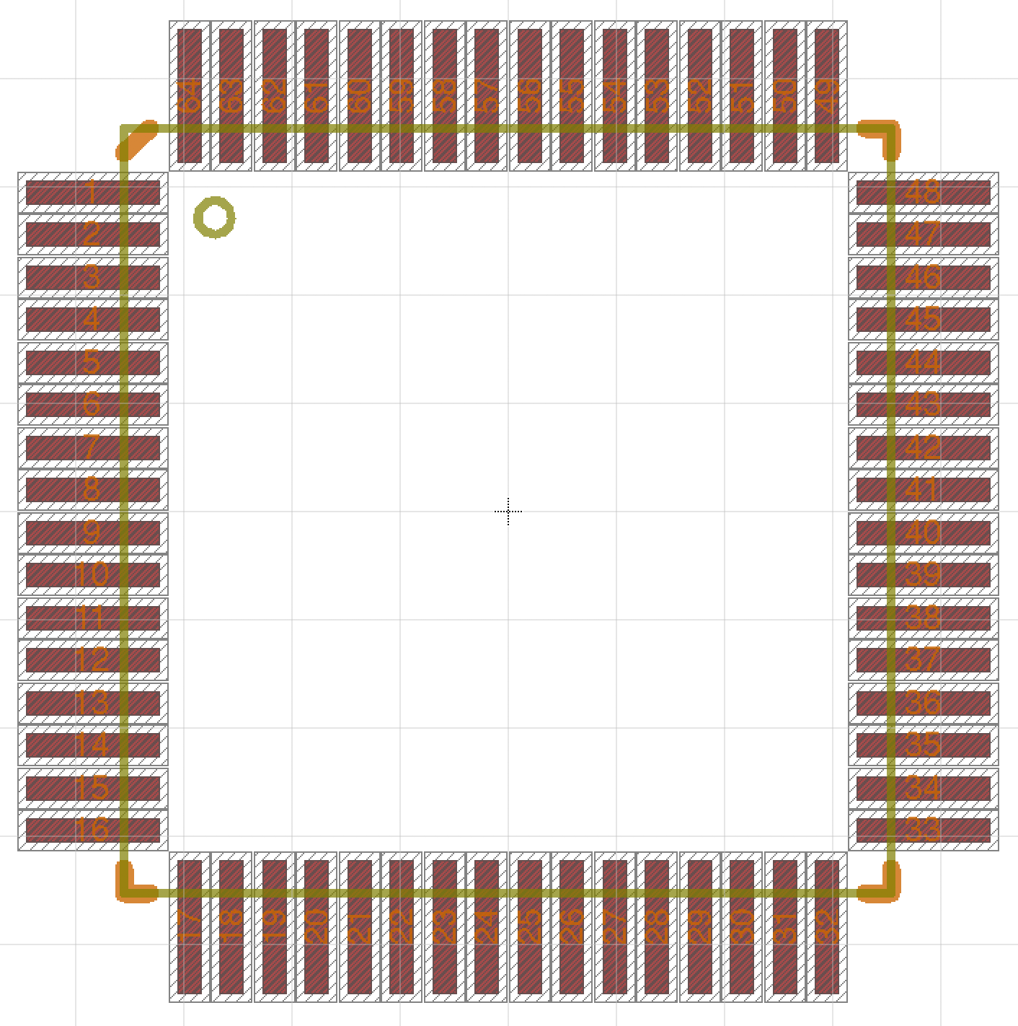
The Library
Physical part
Package
Device Pin Mapping
Symbol

Slide 23
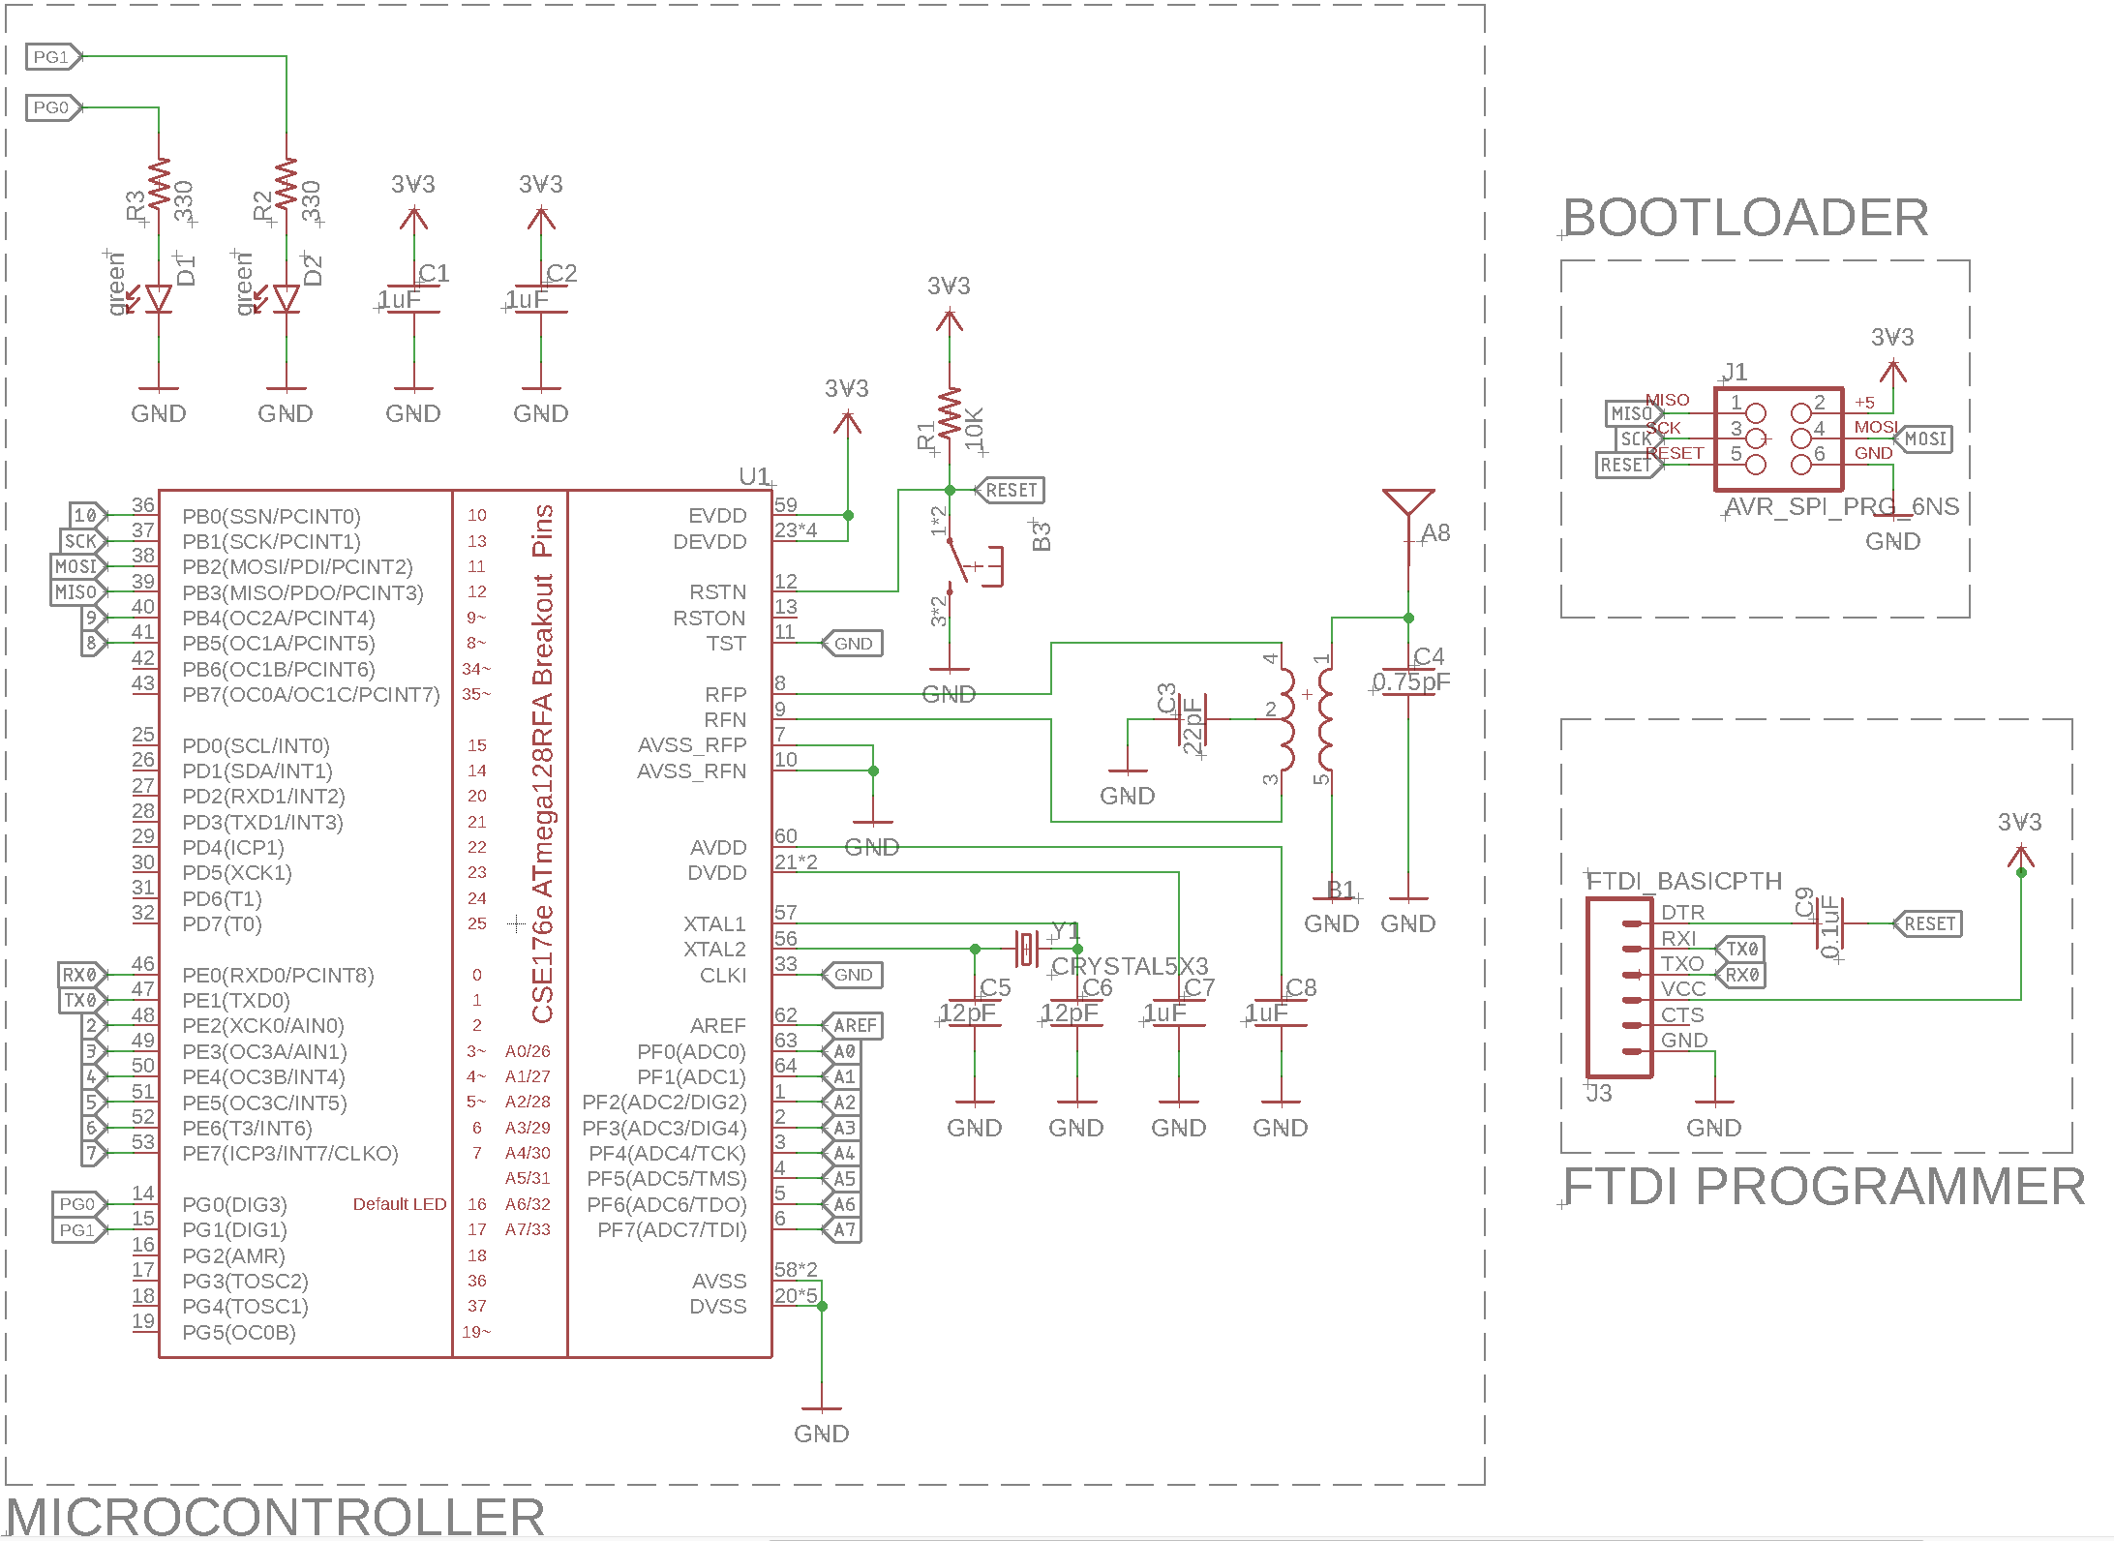
Schematics
Schematics define the electrical connections between parts
It abstracts away everything mechanical about the design
e.g., all resistors look the same
Size is not important
Location is not important
Schematic priorities
Correctness, readability, clarity

Slide 24
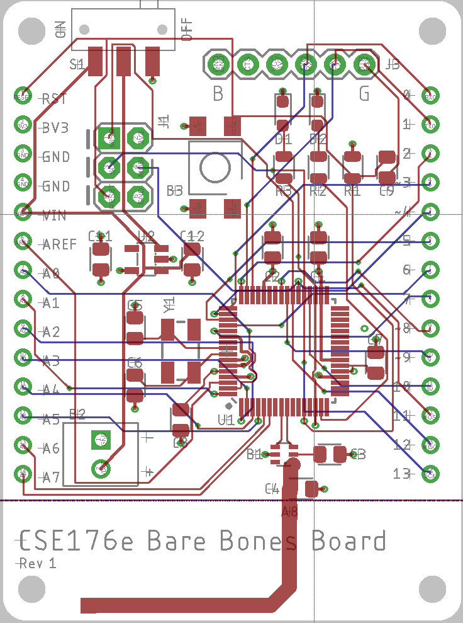
PCB Layout
The layout maps the schematic to a physical thing
Symbols -> Footprints
Wires -> copper traces
The size, shape, and location matter
Layout priorities
Correctness (electrical + mechanical)
Manufacturability
Tidiness
Readability

Slide 25
Schematic vs. Board

Slide 26
Designing with Layers
Eagle (and other board design tools) use layers to specify different types of information about a design.
Where wires should go on each physical layer
Where wires should not go on each physical layer
Documentation
Mechanical information
Eagle defines 52(!) layers by default
‘t’ prefix means top.
‘b’ prefix means bottom (displayed mirrored)

Slide 27
Eagle Layers
Top | Tracks, top side |  | 27 | tValues | Component VALUE, top side
Route2 | Inner layer |  | 28 | bValues | Component VALUE, bottom side
Route3 | Inner layer |  | 29 | tStop | Solder stop mask, top side (gen. autom.) |  | Design
Route4 | Inner layer |  | 30 | bStop | Solder stop mask, bottom side (gen. Autom.) |  | Documentation
Route5 | Inner layer |  | 31 | tCream | Solder cream, top side |  | Tool guidance
Route6 | Inner layer |  | 32 | bCream | Solder cream, bottom side
Route7 | Inner layer |  | 33 | tFinish | Finish, top side
Route8 | Inner layer |  | 34 | bFinish | Finish, bottom side
Route9 | Inner layer |  | 35 | tGlue | Glue mask, top side
Route10 | Inner layer |  | 36 | bGlue | Glue mask, bottom side
Route11 | Inner layer |  | 37 | tTest | Test and adjustment information, top side
Route12 | Inner layer |  | 38 | bTest | Test and adjustment inf., bottom side
Route13 | Inner layer |  | 39 | tKeepout | Restricted areas for components, top side
Route14 | Inner layer |  | 40 | bKeepout | Restricted areas for components, bottom s.
Route15 | Inner layer |  | 41 | tRestrict | Restricted areas for copper, top side
Bottom | Tracks, bottom side |  | 42 | bRestrict | Restricted areas for copper, bottom side
Pads | Pads (through-hole) |  | 43 | vRestrict | Restricted areas for vias
Vias | Vias (through all layers) |  | 44 | Drills | Conducting through-holes
Unrouted | Airlines (rubber bands) |  | 45 | Holes | Non-conducting holes
Dimension | Board outlines (circles for holes) |  | 46 | Milling | Milling
tPlace | Silk screen, top side |  | 47 | Measures | Measures
bPlace | Silk screen, bottom side |  | 48 | Document | Documentation
tOrigins | Origins, top side (generated autom.) |  | 49 | Reference | Reference marks
bOrigins | Origins, bottom side (generated autom.) |  | 51 | tDocu | Detailed top screen print
tNames | Service print, top side (component NAME) |  | 52 | bDocu | Detailed bottom screen print
bNames | Service print, bottom s. (component NAME)

Slide 28
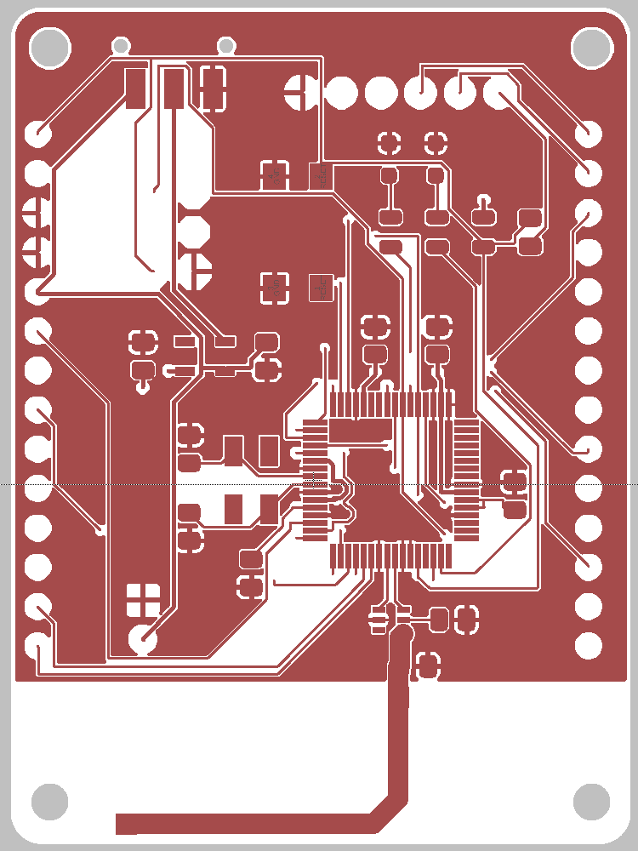
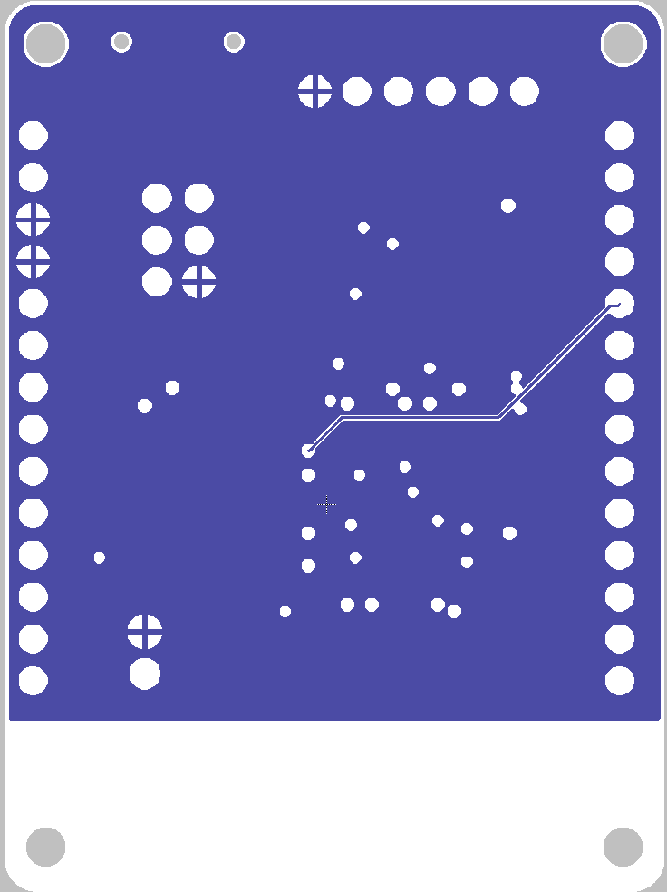
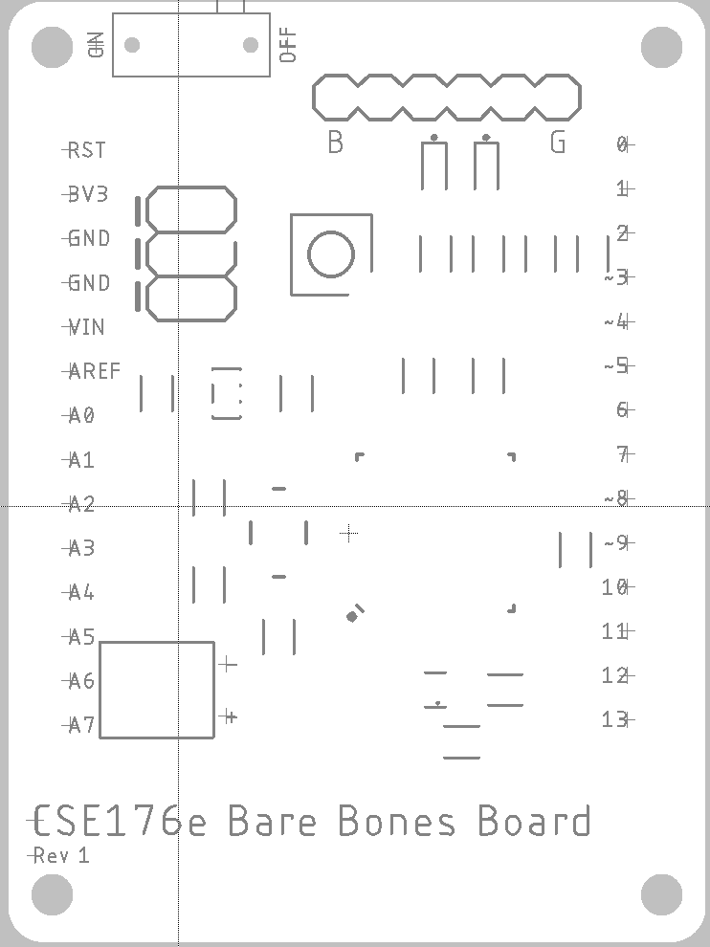
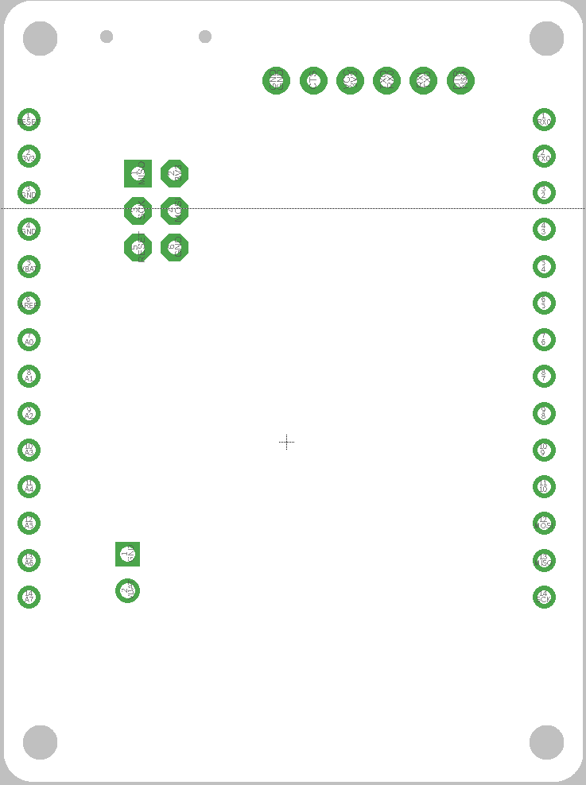
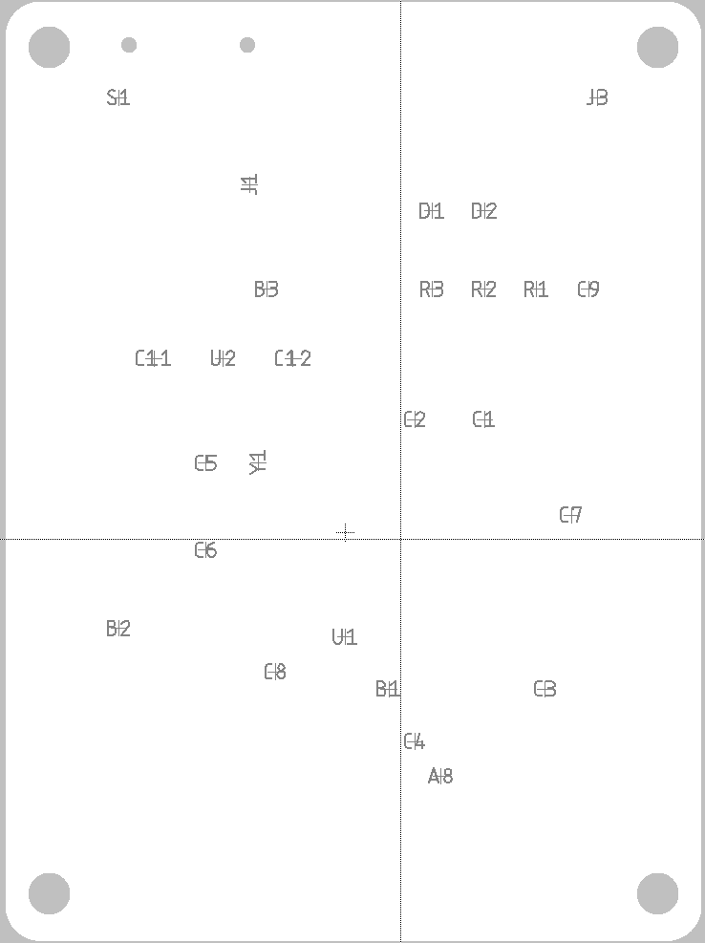
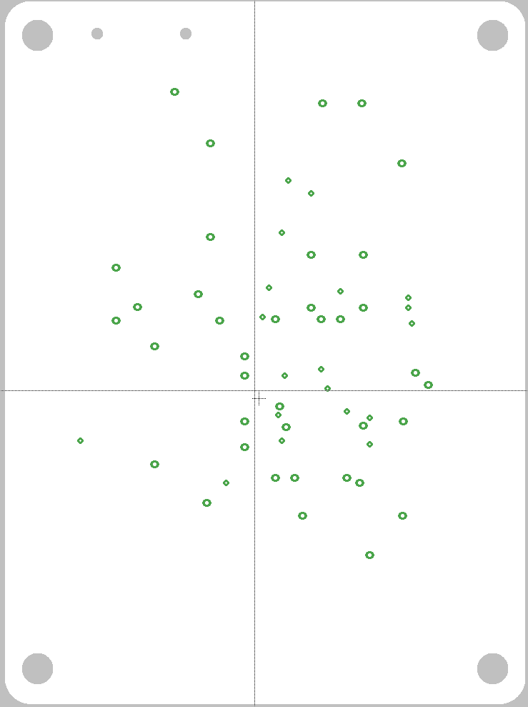
Top (metal)
Bottom (Metal)
tPlace (top silkscreen)
Pads (through-holes)
tNames (top part names)
Drills (pads + vias)

Slide 29
Useful Layer Commands
“display <layer>” -- show the layer
“display -<layer>” – hide the layer
“display last” return to previous view
Click and hold the layer tool icon to get a list of present layers sets.
Select “new…” to save the current view
Then “display foo” to switch to the view named “foo”

Slide 30
Manufacturing
Eagle layers are partly Eagle-specific
Some are semantic
Some are documentary
Some correspond to physical layers
Boards manufactures need
Metal layers
Silkscreen
Soldermask
Drills
All in a standard format

Slide 31
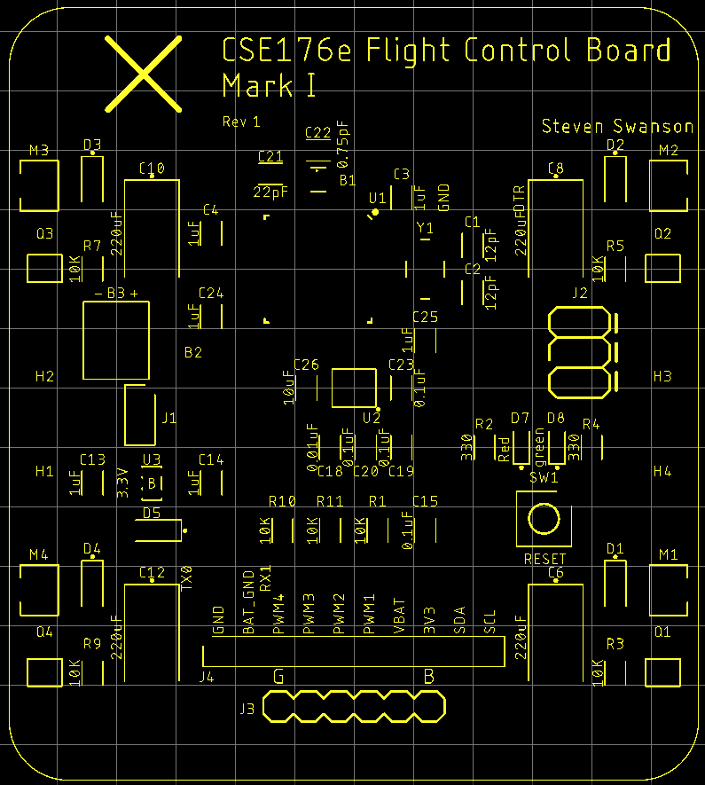
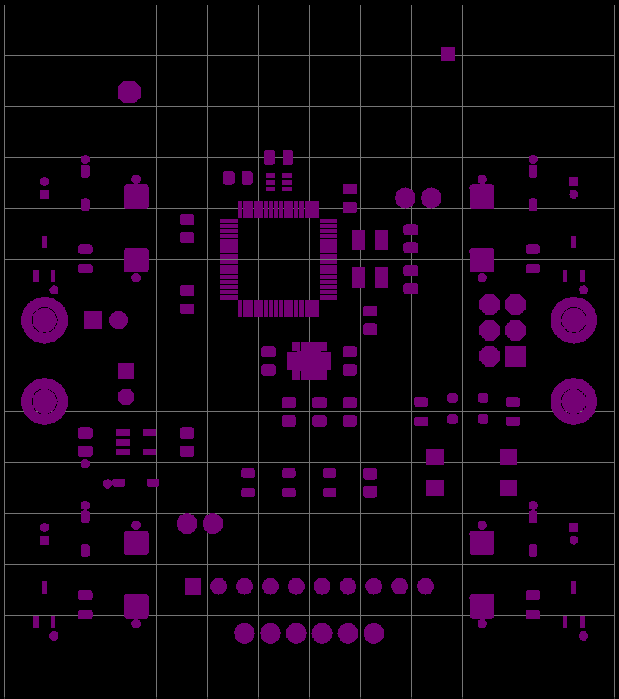
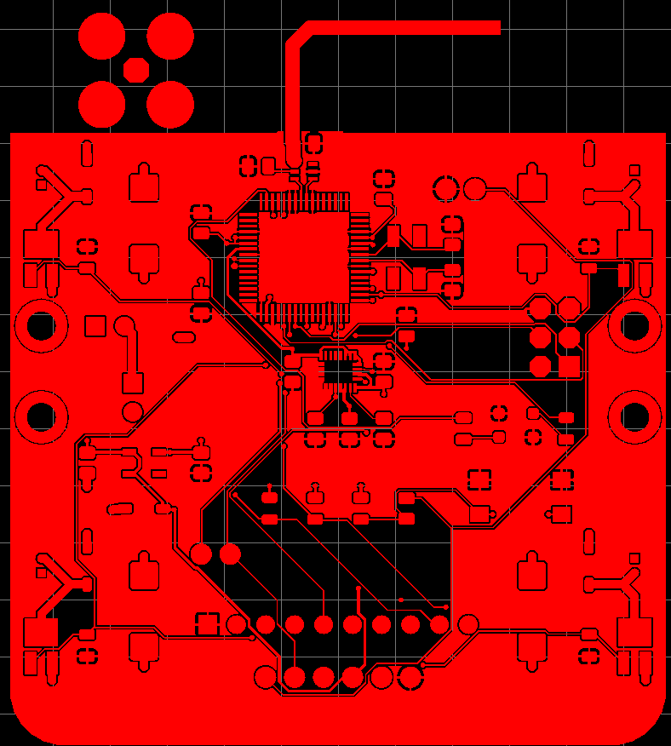
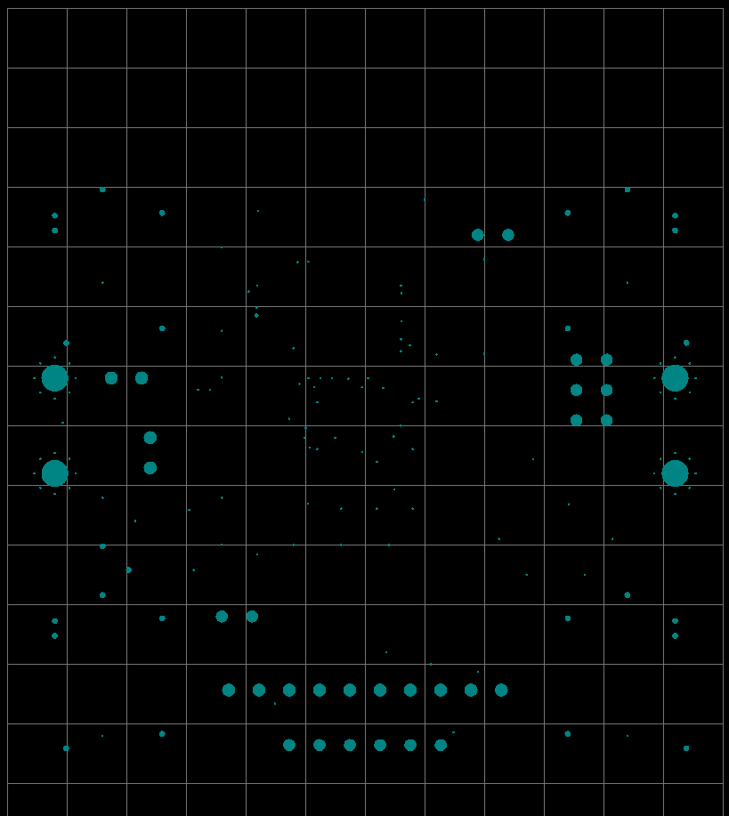
Computer Aided Manufacturing (CAM) Files: Gerbers
Eagle’s CAM processor generates CAM files
“Gerbers” – precise drawings of the physical layers.
“Drill file” – Where to drill the holes
Manufacturing Requirements
Minimum drill size
Minimum feature width
File formats and names
Our manufacturer: https://www.pcbcart.com/pcb-fab/standard-pcb.html
Our configuration encodes their requirements
QuadClass-Resources/Eagle/DRU/pcbcart-4layer.cam

Slide 32
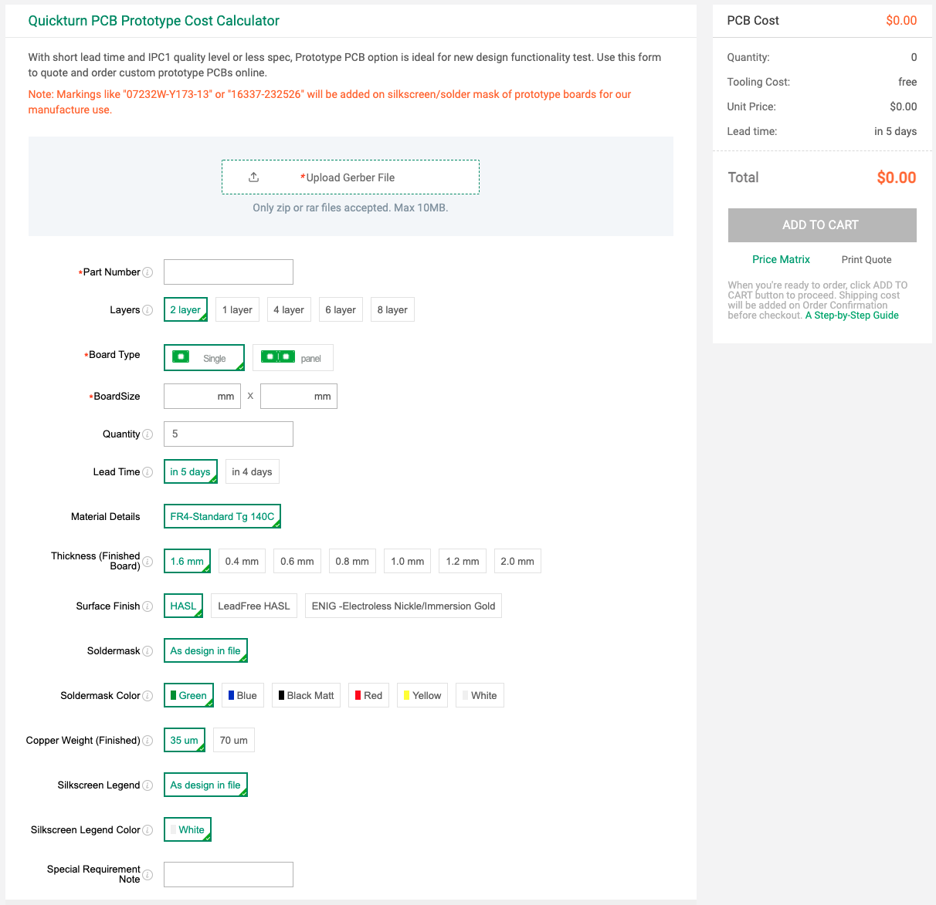
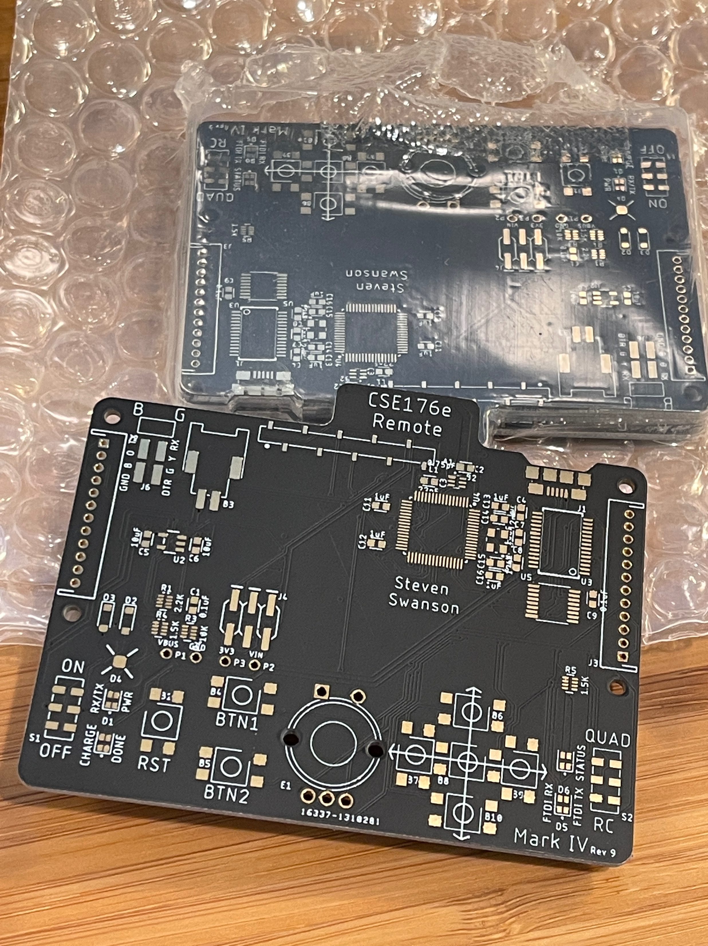
Submitting for Manufacturing
Ordering PCBs is easy
Make a zip file of your gerbers
Upload it select some options
Quantity
Board thickness
Solder mask color
Board size.
Layer count
They will check your design
Boards arrive in ~1 week

Slide 34

Designing PCBs with Eagle

Slide 35
Eagle Tips and Tricks
Setting the grid
Making lines straight

Slide 36
Next time:
Major points of confusion in this lab
How to set and align to grid
How to make wires straight
Where to look for the SMD location in the button datasheet
Adafruit tutorial is not consistent with our guidance

Slide 37
The Lab
Use Eagle to design a simple schematic and board.
Run it through the tool flow.
Submit it through Eaglint

Slide 38
Eagle uses odd terminology
”Pads” are through hole connections
SMD (surface mount device) are surface mount connections.

Slide 39
Eagle Lint
A “lint” tool:
Tool to check coding standards and other invariants about a system.
Eaglint will check your libraries, schematics
Check for correctness
Check for style
Also checks for other files in your repo
Eaglint will tell you what it’s looking for.
Pay attention.
Provides a workflow for me to review your designs and provide feedback.
To use
Visit http://eaglint.nvsl.io
You received a welcome email a couple of nights ago.

Slide 40
Eagle Lint Process
Commit and push your changes to github
Submit your repo to Eaglint for a quick check
Submit your repo to Eaglint for a full check
If warnings/errors
Fix and goto 1.
Submit for human review
If rejected
Read comments; goto 1.
Else if accepted
Goto next lab

Slide 41
Eaglint Demo

Slide 42
Grading on PCB Labs
The key to PCB design is attention to detail.
Building a real board can take 4 months.
If you make a mistake, it takes 4 months to fix.
Contrast to software: just recompile and rerun!
Don’t make any mistakes! Check your work!
Grading for PCB labs
A “perfect” score is 10 points
You start out with 11-12 points (depending on the lab).
Every time you submit a design to Eaglint, you lose 1 point.
Every time you submit a design for human review Eaglint, you lose 1 point.
You must complete the labs.
“Quick checks” are free.

